Slide 1
Developer Services Water Technical Forum
October 2023
Andrew Smith, Chris Heywood, Rachel Yates

Slide 2
Customer Operations Delivery Manager
(Developer, SLP and NAV)
Paul Heavey
Customer Area Manager Water (North)
Andrew Smith
Customer Area Manager
Water (South)
Steve Marsh
NAV and Asset Protection Manager
Teresa Helm
Developer Relationship Manager
Samantha Mottram
Design Engineers
Developer Services Inspectors
Assistant Engineers
Construction Engineers
Design Engineers
Construction Engineers
Developer Services Inspectors
Assistant Engineers
Design Engineers
Assistant Engineers
Customer Team Leader
Data Asset Team Leader

Slide 3
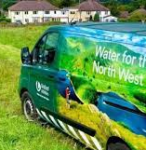
Water Guidance Update
Andrew Smith Customer Area Manager - North
Notes:
Intro

Slide 4
Water Guidance Update
Novation / Termination Agreements
What Is the difference between the two agreements?
Novation – where all parties agree to continue with same T&C’s in the original SLA Termination – where the original SLA is terminated, and new agreement set up between new parties on the current years T&C’s for remainder of the site
DocuSign
Reminder about DocuSign – all agreements can be sent via this method
In order for us to provide this we need a Named person and their email address for all parties, it cant be an unnamed emailed address – if you would like more info on DocuSign let us know
WIAPS
Reminder about the Process regards WIAPS certificates
It is the responsibility of the SLP to keep and store WIAPS certificates for developments in case of audit by or water regulatory enforcement team - info required on them
Reminder regarding the Selflay mailbox
When sending applications or queries always send to the mailbox (selflay@uuplc.co.uk) and not individual emails so we can monitor requests effectively (you can copy individuals in if you wish).
This will allow us to monitor effectively, also always create a new email for new development and never forward and just change the email title.
Notes:
SLA for WIAPS to be provided – 2 working days
F10 – Works will not be released without the correct paperwork

Slide 5
Applications to self lay service connections
?
We increased the number of contestable activities that SLPs can carry out – including self laying service connections.
What is the Lloyd’s Register?
Lloyd’s Register operate the Water Industry Registration Scheme (WIRS) on behalf of water utility companies and the WIRSAE accreditation on behalf of Market Operator Services Ltd (MOSL) and water wholesalers.
A WIRS accredited self-lay organisation may perform works on the connection of water mains and supplies to a property, dependent on the status and scope of accreditation.
What does this mean for you?
You’ll need to ensure you’re Lloyd’s Register accredited for construction and Water Design, or use a WIRS accredited Water Designer, before you apply
There are also some specific technical criteria your application needs to meet
SLPs with 'CRUPMC, Construction Routine Under Pressure Mains Connections Accreditation' can apply under pressure branch connections up to 63mm off designated mains for either non standard services or mains. We are reviewing this to increase to 90mm & 110mm.
11 Whole site from Branch to meter fitted done all by the SLP, No construction involvement completed by United Utilities
Notes:
This slide needs updating with the Stats

Slide 6
DADs Project Closedown - Outstanding Asset Payments Pre 1 April 2018
Proposal to allow 90mm -110mm branch connection contestability from April 2024
The proposal does not represent an increased risk to UU Network
No proposal to increase the size of the host main this will remain at 12” any larger main will automatically non contestable
If volumes reached a level that make a CE being on site for every connection unattainable, a risk based approach would be followed based on the connection.
The only thing changing is the size of the connection being made (90mm and 110mm)
No change to any criteria with regard to UU’s existing assets or the techniques used to make the connection
Risk based approach
Host main size / material
Number of props which could be impacted
Experience of SLP (DS knowledge)
The “rules” will remain the same as the current for up to 63mm branch connections
Construction Engineers would be onsite at the time the branch connection is made.

Slide 7
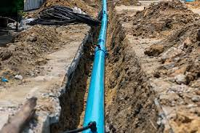
DADs Project Closedown - Outstanding Asset Payments Pre 1 April 2018
Rules - mitigation of risk
Only SLPs with CRUPMC* are allowed to carry out 25mm, 32mm, or 63mm branch and service connections to host mains up to 12” diameter
Host main must be DI/ CI/SI/AC/PE/ Barrier Pipe /Steel
Only under pressure connections are allowed
The host main must not be strategic and must serve less than 500 properties otherwise the branch connection is non-contestable
Shut off required - branch connection is non-contestable
*Construction Routine Under Pressure Mains Connection

Slide 8
Connections to Existing – What's the process?
Apply for your Connections, tell us the location, plans & preferred point of connection.
We will asses the application as normal and confirm the POC with the quotation.
We will send you site costings, plot reference numbers and a unique connection reference number
Complete & return the new ‘Request for Permission to Work Form’ with the unique reference number and proposed connection date
Make the connection on the agreed date – Ensure you contact the Construction Engineer before and after work carried out.
Notify us within 24 hours of work being completed
Return your “Completed Work Form” to us with photographs of works and meter details. (VYN)
Return your signed acceptance and payment
SLP step 1
SLP step 4
SLP step 5
UUW step 1
SLP step 3
SLP
step 6
UUW step 2
SLP step 2

Slide 9
Simplified steps for Contestable branch connections – process?
Apply for your design approval & identify any work that you would like to complete in line with the ACS
We will asses the application as normal and confirm contestable works with the quotation.
We will send you site costings, plot reference numbers and a unique connection reference number
Return your signed acceptance, signed agreement and payment
Complete & return the new ‘Request for Permission to Work Form’ with the unique reference number and proposed connection date
We will confirm the connection date and inform our network teams of your intended work
Make the connection on the agreed date – Ensure you contact the Construction Engineer before and after work carried out.
Notify Selflay within 24 hours of work being completed
Return your “Completed Work Form” to us with photographs of works
SLP step 1
UUW step 2
SLP step 4
UUW step 1
SLP step 3
SLP step 5
UUW step 3
SLP step 2
SLP
step 6

Slide 10
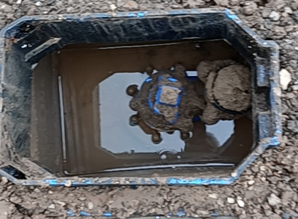
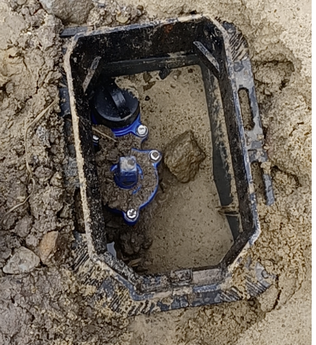
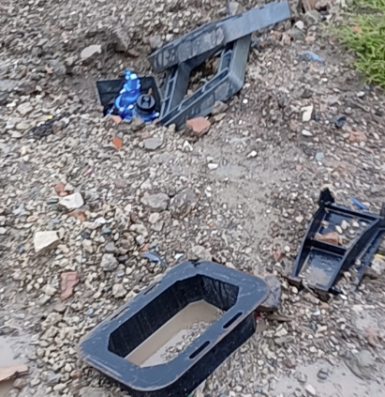
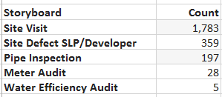
Defect Reporting by our Developer Services Inspectors (DSI)
DSI are now be on site to carrying out audits/inspection on assets installed by SLP’s, these series of checks are vital to ensure that we’re adopting reliable assets that can be easily maintained and repaired will continue to serve our customers for many years. Our APP, VYN will provide YOU and us of this evidence.
Since October 2021, we’ve had a full compliment of DSI covering the North West. We have now gathered evidence of what standards our DSI are coming across when completing these site visits:
More opportunities to share best practice
System in place to capture and share good/bad defects with Vyn
Right first time – minimal disruption
Future resilience for customers
Notes:
Need to add images of good and bad

Slide 11
Where we are up to?
Infringement process – Developer and SLP
We have a new dashboard to compile the history of the site we are visiting. You will receive an infringement notification from our DSI and before receiving a quote for repair, you have 28 days to rectify. After such period, we will be notifying you that we will be carrying out this work at a cost to you.

Slide 12
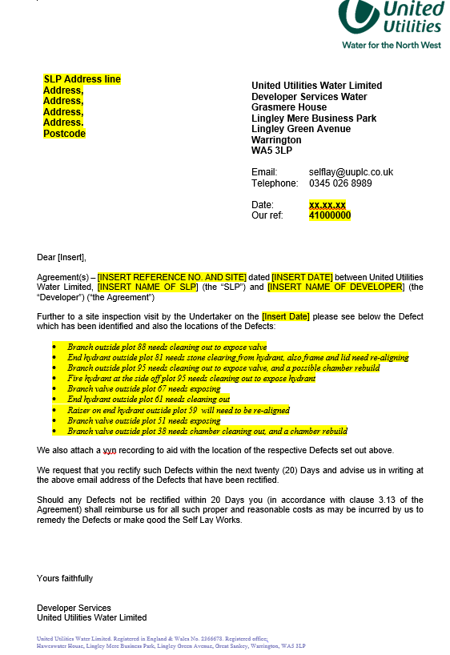
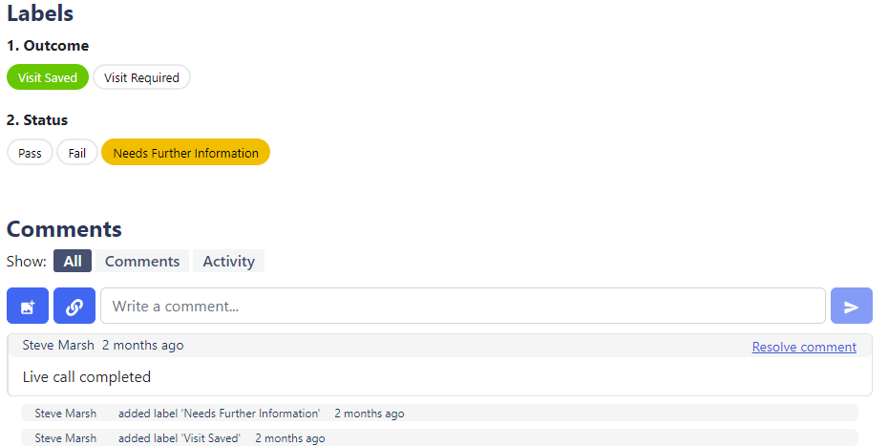
Infringement process – Developer and SLP
As the below, we will be sending you a unique web link to Vyn, so you are able to prove rectification of the assets.
DRAFT

Slide 13
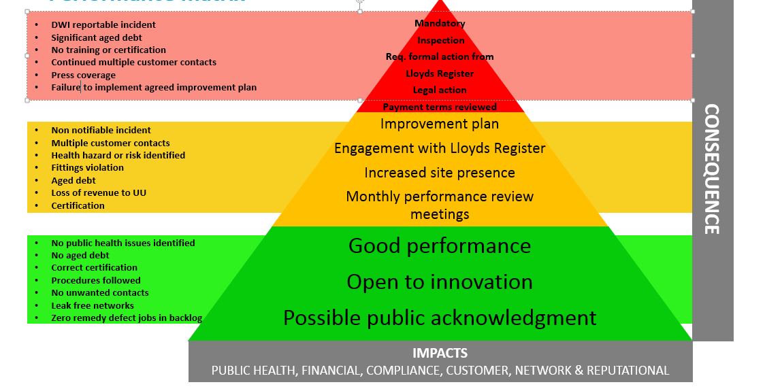
Proposed stakeholder matrix for compliance

